Slide 1


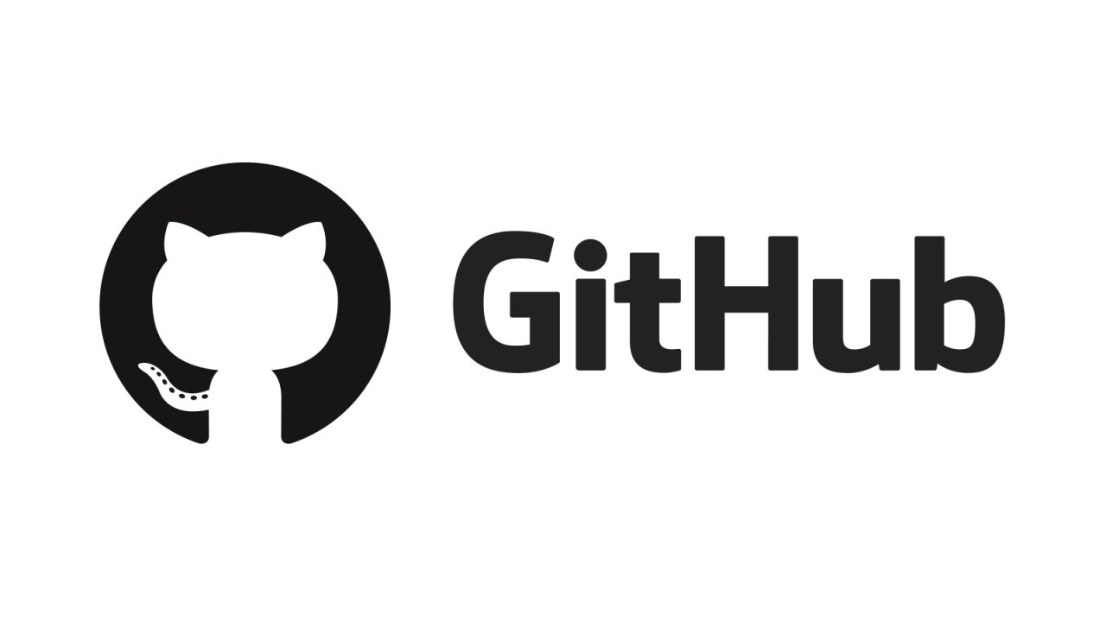
Opensource, Git and GitHub
By: Suyash Agarwal

Slide 2
What is Open Source
The term “open source” refers to something which people can share or modify because its design is publicly accessible
Open source is a publicly accessible assortment of libraries, software, projects, distributions where people can build, improve and share software for the betterment of humanity.
Open Source unlocks the world’s potential
Its generally free
Open Source benefits both the users and programmers

Slide 3
Principles of Open Source
Transparency: When all materials are accessible for a specific project, we can build upon each other's ideas and discoveries. We can make more effective decisions and understand how those decisions affect us.
Collaboration: When we're free to participate, we can enhance each other's work in unanticipated ways. No matter which part of the world you are from, one can collaborate effectively
Rapid prototyping: Rapid prototypes can lead to rapid discoveries. When you're free to experiment, you can look at problems in new ways and seek answers in new places.
Meritocracy: Good ideas can come from anywhere, and the best ideas should win.
Community: Communities form when different people unite around a common purpose. Shared values guide decision making and community goals supersede individual interests and agendas

Slide 4







Some examples of Open Source software
Linux
Git
TensorFlow
Apache Web Browser
Telegram
WordPress
Arduino

Slide 5

Proprietary Software
Proprietary software, often called closed-source software, is any software that is copyrighted and bears limits against use, distribution and modification that are imposed by its publisher, vendor or developer.
Proprietary software remains the property of its owner/creator and is used by end-users/organizations under predefined conditions.
The vendor always makes the user sign and EULA (End user license agreement) or a TOC (Term of service agreement). Which……..well no one reads :D
One can only use the software. He cannot make any changes in the software’s functionality or share or improve it. Only the developers of the project have the luxury to do that

Slide 6





Some examples of Proprietary software
Microsoft Windows
Microsoft Office
Adobe Photoshop
PyCharm by Jet Brains
WhatsApp

Slide 7

Google Summer of Code

Slide 8
What is GSoC?
Google Summer of Code (GSoC) is an online, international program designed to encourage university student participation in open source software development
Students work for an open source software organization, and earn a stipend for successfully completing the project
Open source software projects apply to be a mentor organizations
Students submit project proposals to mentor organizations. Who start working under the organizations once their proposal has been accepted
Students who pass each evaluation are paid a stipend for their work
Countries with the most students:
India (2262), United States (2202), and Germany (717)

Slide 9
Goals of GSoC program
Help organizations continue to identify and bring in new developers each year
Expose students to real world software development scenarios
Help students build a strong network when applying for jobs
University students spend their time outside of school working in a field that can help them with their studies and career after university
Increase the importance of open source development and spread awareness about it. Approximately 70 million lines of code have been produced since its inception!

Slide 10
What is Git?
Git is a distributed version control system for tracking changes in the source code during software development
It was developed by Linus Torvalds while he was building his Linux kernel
It is one of the most groundbreaking technologies created ever since the discovery of computer programming!
A version control system is a software to keep track of different versions of a file so that it becomes more efficient to find differences between the versions, help catch bugs, fix issues.
Keeping track of a project’s progress also becomes a lot easier using Git

Slide 11
What is GitHub?
GitHub is a platform that helps people solve problems, by building software together
No matter which part of the world you are in, people can easily collaborate and work on different projects
People can report bugs, request features, or even just ask questions
GitHub uses Git to keep track of changes made to a code and help create an isolated environment to develop new features while the project doesn’t gets affected till the changes are not “committed”
It maintains checkpoints for every programmer’s contribution so as to efficiently synchronize workflow
It’s the way how we build software, i.e., together ☺

